Slide 1
Sign Language Gesture Recognition
(Project Guide: Ms. Neetu Singh)
Abhishek Saklani (00876802714)
Hasneet Singh (03676802714)
Shivam (60176802714)
Sourajit Sanyal (00476802714)

Slide 2
Introduction
A gesture is “a movement of part of the body, especially a hand, to express an idea or meaning”.
Sign Language Gesture Recognizer (SLGR) is a tool for recognizing sign language of deaf and dumb people of the world and translating that into natural language.

Slide 3
Why we need SLGR?
According to MOSPI About 4 million people are deaf and dumb in India.
They are deprived from various social activities.
They face problem due to their inability to communicate in daily lives.

Slide 4
How SGLR can help? An Example…..
Suppose a deaf/dumb patient is at the hospital. She is trying to express her demands to the nurse using sign language but the nurse can not understand her demands.
This may cause moments of discomfort for both the nurse and the patient.

Slide 5
Key Steps
Obtain images from camera.
Divide obtained images in training and testing set.
Train a Convolutional Neural Network.
Now test the model to recognize gestures by getting images from camera.

Slide 6
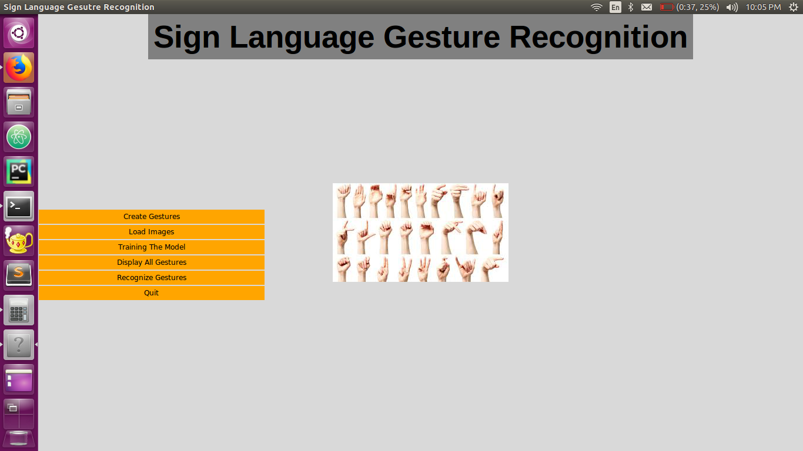

Slide 7
Create Gestures
Using this we can create our own custom gestures with the help of webcam and OpenCV.
Preprocessing the captured images using computer vision techniques to extract features.
1200 images are captured for each gesture.

Slide 8




Display All Gestures
Give
Namaste
Okay
Thanks

Slide 9
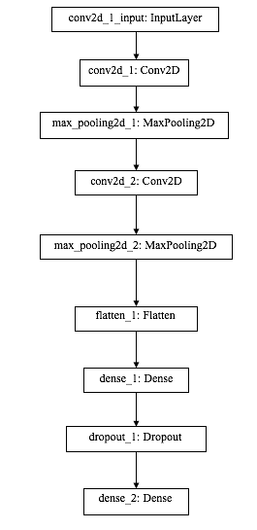
Convolutional Neural Networks
Layers in CNN:
Convolution
Activation
Pooling
Fully Connected Layer

Slide 10
Recognize Gesture
Live feed from the webcam is broken into frames.
The images are preprocessed & contours are drawn.
Once number of frames of a gesture exceeds a threshold, they are passed to Model for prediction.
The predicted output is shown on the screen as word and is converted to speech.

Slide 11
Result
This project helps in bridging communication gap between dumb community (differently abled) of society.
We aim to provide a solution for helping the dumb people in hospitals.
The accuracy of the model is 65%.

Slide 12
Cost Analysis & Scalability
Raspberry Pi with screen and webcam(one time cost)= 4000 INR/each bed
Cost of Basic Computer with operating system and applications(one time cost)=70000 INR
Cost of cloud based server=350 INR/each bed per month

Slide 13
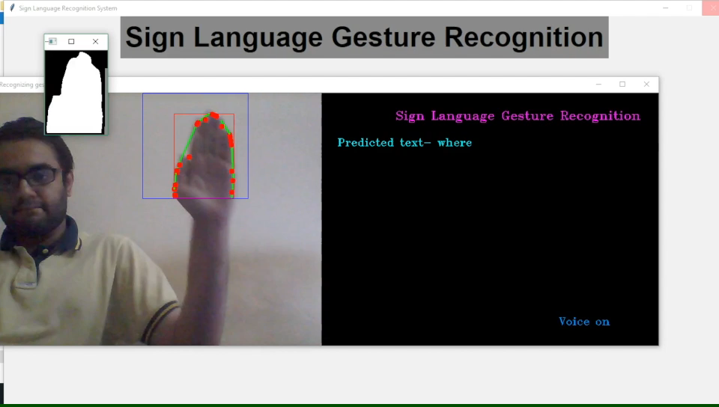
Video of working project

Slide 14
Conclusion & Remark
We used convolution neural network to create an application to help people who are not able to speak.

